Slide 1
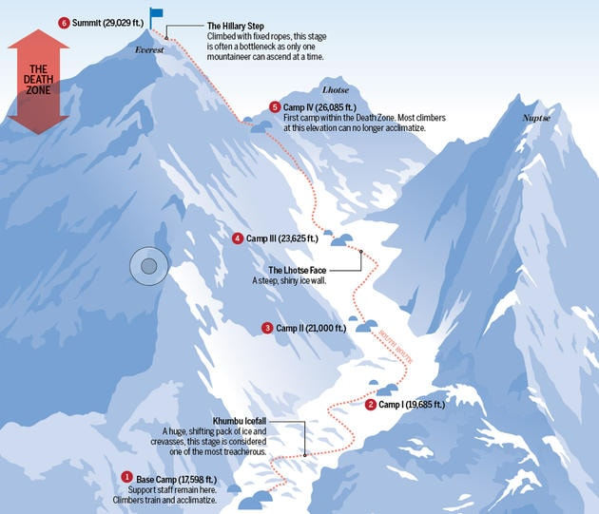
The South route
The Hillary Step – climbed with fixed ropes, this stage is often a bottleneck as only one mountaineer can ascend at a time.
Everest Base camp – 17,596 ft
Support staff remain here. Climbers train and acclimatize.
Khumbu Icefall – A huge shifting pack of ice and crevasses, this stage is considered one of the most treacherous.
Summit ( 29,029 ft)
The Lhotse face – A steep shiny ice wall.
Camp 1 ( 19,685ft)
Camp 2 ( 21,000 ft)
Camp 3 ( 23,625 ft)
Camp 4 ( 26,085 ft) First camp within the death zone. Most climbers at this elevation can no longer acclimatize.

