Slide 1
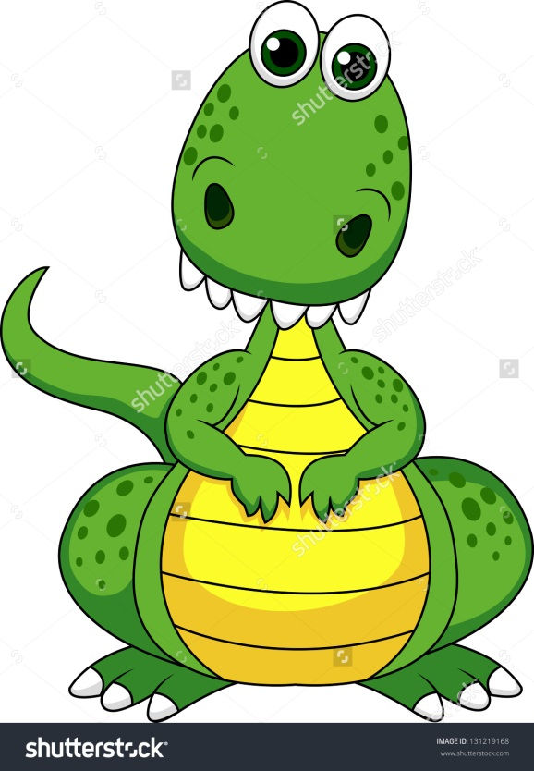
All About Worry
and when it gets too much

Slide 2

Why do I worry?
Everybody worries
We are designed to worry!
Worry keeps us safe!
Worry is a way for us to work out if something is dangerous or risky
Being worried about things is normal

Slide 3
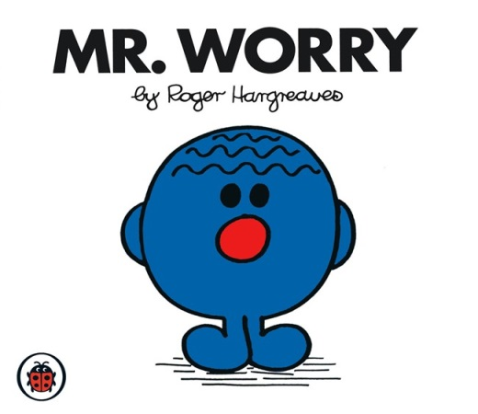
But…
Sometimes worry can make us upset
Sometimes it stops us from doing something
Sometimes we don’t know what to do when we are worried about something
Sometimes we have too many worries and it gets too much!

Slide 4
Today
We are going to learn about what happens to our brains and bodies when we worry
We are going to learn and practice some ways to helps us feel calm when we worry

Slide 5

How do I know when I am worried?
What does worry feel like?
What behaviour might I have when I am worried?

Slide 6
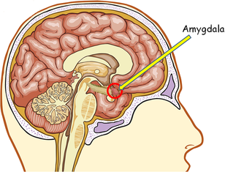
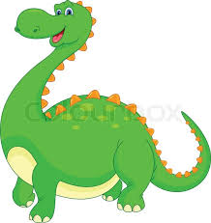
There is a dinosaur in my brain!
There is a very old part of our brain called the amygdala
Its so old it’s prehistoric
It’s the bit of our brains that keeps us alive
It’s the bit that helps us stay safe

Slide 7
The Dinobrain wakes up!
The amygdala (Dinobrain) decides it needs to save your life….
It sends a hormone called adrenaline round your body… really, really, fast (so your heart goes even faster!)
This fuels your muscles… this means the front of your brain (the super evolved human bit) can decide what to do…
Hide, run away or fight what ever is worrying you
Notes:
Now add adrenaline

Slide 8

Not always a good thing!
Oops … your amygdala (Dinobrain) is very old and a bit basic
It thinks you need to sort out a sabre cat or a mammoth charging at you…when actually you might be worried about something like:
  Going to a new place
  Meeting new people
  The number of likes you have on Facebook
Sometimes it takes over from the front of your brain (the clever thinking bit) and Dinobrain is not that clever at making decisions

Slide 9
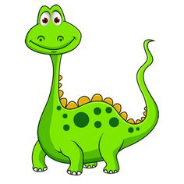
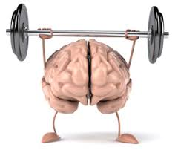
What can I do to calm the Dinobrain down?
We need to make sure Dinobrain doesn’t take over from our clever thinking brain.

Slide 10
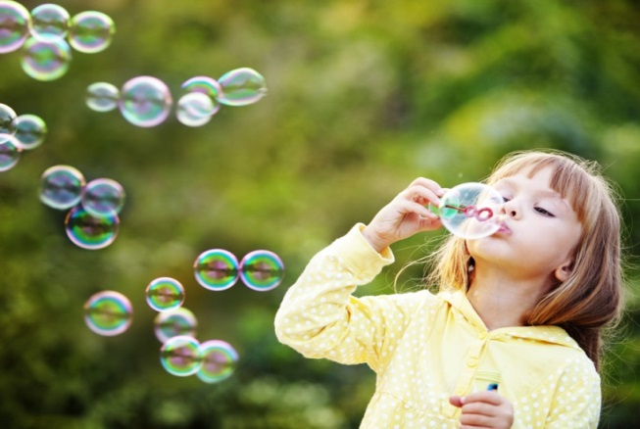
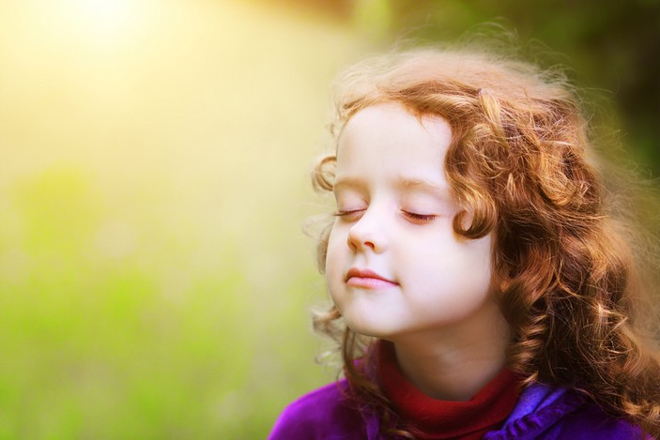
Slow our heart down
Lets stop all that adrenalin – this will help calm Dinobrain down
The easiest way to slow the adrenalin is to slow your heart (not by much)
We can do this by breathing slowly…

Slide 11
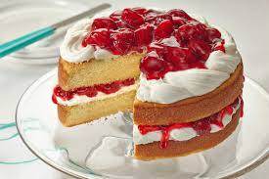
Happy thoughts

Slide 12

Lets distract the Dinobrain

Slide 13

Do stuff
What’s your favourite thing to do?
  Dance
  Sing
  Play football
  Paint
  Draw
  Watch something funny on YouTube
  Make something funny for YouTube

Slide 14
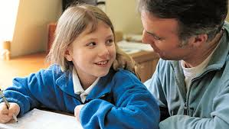
Tell someone
It’s a really good idea to tell someone you trust if you are worried about something
It’s ok to share with friends BUT it’s usually a good idea to let an adult know you are worried
Who could you talk to? (Mum, Dad, Step mum, Step dad, Sister, Brother, Auntie, Uncle, Grandma, Grandad, Teacher)

Slide 15


I can trick the Dinobrain
We can change our thoughts which will fool the amygdala that there isn’t a problem
If we change the way we think about something it’s like magic…

Slide 16
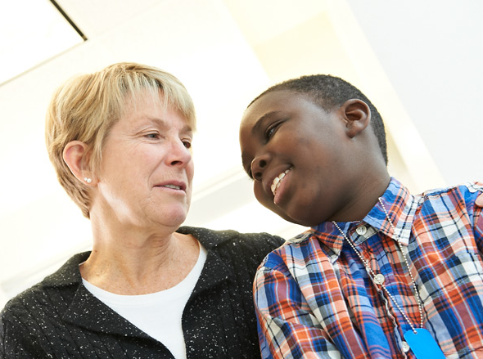
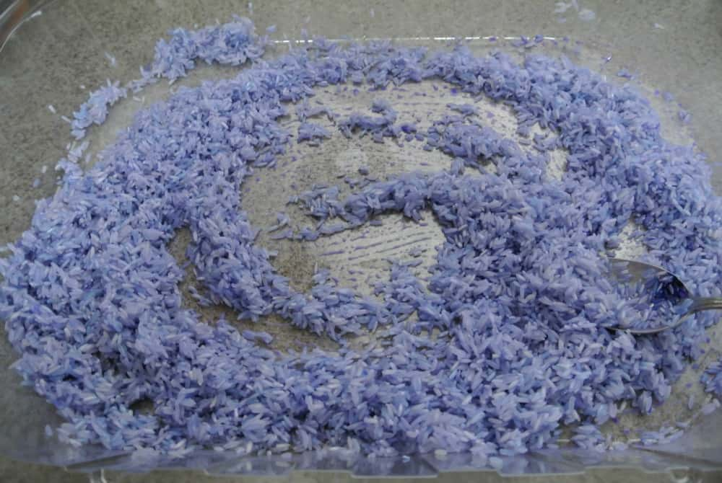
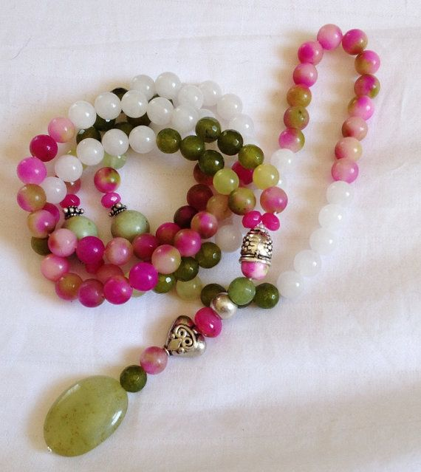

Everyone is different and so everyone needs to calm their Dinobrain differently

Slide 17
Make a plan
What worries me. | How do I feel when I am worried. What do I do?
What can I do to feel calm | Who can help me.

Slide 18

A plan!
I really worry about getting lost when I am driving
I have a plan – I told my husband and he got me a sat nav
Sometimes the sat nav doesn’t work
That’s ok because I can:
  ask for directions
  I can ring the place I was going
  I can pull over and go and get a coffee
  I won’t stay lost. I don’t need to worry

